Slide 1

Anomaly Detection in Credit Card Transactions (Group D)
This presentation explores the crucial topic of anomaly detection in credit card transactions. It is important that credit card companies are able to recognize fraudulent credit card transactions so that customers are not charged for items that they did not purchase.
Members (Group D) :
Chad T Chiu
Satya Shiva Sai Ram Kamma
Gurnit S Chauhan
Tanush Bhaskar Shetty

Slide 2

Introduction to Anomaly Detection Techniques
1
Anomaly Detection
2
Objective
This project focuses on identifying fraudulent credit card transactions. The dataset is highly imbalanced, with fraudulent transactions comprising only a small fraction of the total.
The objective is to detect anomalies with high recall while minimizing false positives. This means identifying as many fraudulent transactions as possible while avoiding misclassifying legitimate transactions as fraudulent.
3
Techniques
4
Goal
We evaluated four machine learning techniques: Bayesian Gaussian mixtures, PCA, Isolation Forest (not covered in class) , and Random Forest with Balanced Class Weights.
Our goal is to identify the best model for detecting anomalies in this dataset while maintaining a balance between precision and recall.

Slide 3
Dataset Loading Process
Import Libraries
1
The necessary libraries, such as pandas, matplotlib, and seaborn, are imported for data manipulation, visualization, and analysis.
Load Dataset
2
The credit card fraud dataset is loaded from a specified file path using the pandas library.
Display Information
3
The dataset's information, including data types, non-null counts, and memory usage, is displayed using the 'info()' method.
Analyze Distribution
4
The class distribution is visualized using a countplot, highlighting the imbalance between legitimate and fraudulent transactions.

Slide 4
Data Cleaning Steps
Initial Inspection
Duplicate Removal
The dataset contained 284,807 rows and 31 columns. Key features included 'Time', 'Amount', and 'Class'. The 'Time' column represented seconds elapsed between transactions. The 'Amount' column represented the transaction amount. The 'Class' column was the target variable, indicating whether a transaction was fraudulent (1) or not (0).
We identified and removed 1,081 duplicate rows. This resulted in a dataset with 283,726 rows and 31 columns. We also checked for missing values, but none were found. This meant no imputation was necessary.

Slide 5



Data Standardization and Balancing
The 'Time' and 'Amount' features were standardized using StandardScaler. This process sets the mean and standard deviation to 0 and 1, respectively. Standardization improves model performance, particularly for algorithms like SVM or PCA.
Class Imbalance
1
The dataset exhibited a severe class imbalance.
Before Balancing
2
Class 0 (Non-Fraud): 283,253 (~99.83%).
Class 1 (Fraud)
3
Class 1 (Fraud): 473 (~0.17%).

Slide 6
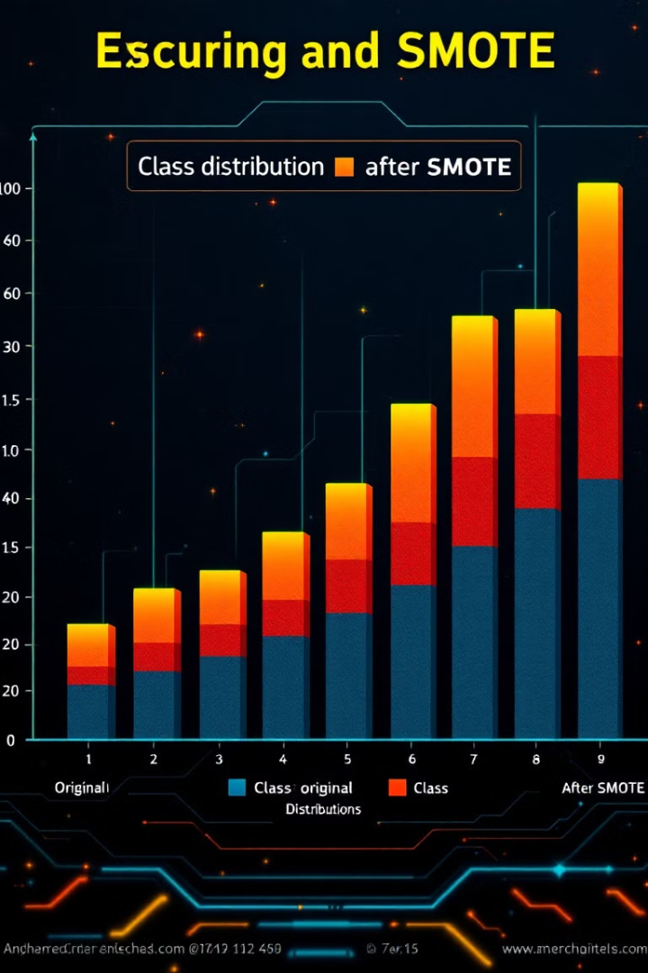



Data Standardization and Balancing
The original dataset exhibited significant class imbalance, with a disproportionate number of non-fraudulent transactions compared to fraudulent ones. This imbalance could lead to biased models that struggle to accurately detect fraud.
To address this issue, we employed the Synthetic Minority Oversampling Technique (SMOTE). SMOTE generates synthetic samples for the minority class (fraudulent transactions), effectively balancing the dataset.
After applying SMOTE, the class distribution became balanced, with an equal number of non-fraudulent and fraudulent transactions. This balanced dataset enables the model to learn from both classes effectively, improving its ability to detect fraud.

Slide 7
GAUSSIAN MIXTURE MODEL
Gaussian Mixture Models (GMMs) are probabilistic models that assume all the data points are generated from a mixture of several Gaussian distributions with unknown parameters.
In the context of anomaly detection, GMMs can be used to model the distribution of normal (non-fraudulent) transactions. Once the model is trained, transactions that have a low probability under the model can be flagged as anomalies, which may indicate fraudulent activity.
Use the Expectation-Maximization (EM) algorithm to fit a GMM to the dataset. The EM algorithm iteratively performs two steps:
Expectation (E) Step: Calculate the probability that each data point belongs to each Gaussian component.
Maximization (M) Step: Update the parameters of the Gaussian components to maximize the likelihood of the data given the currently assigned probabilities.

Slide 8
Implementation
Balancing the Dataset Using SMOTE
Initializing and Training the Gaussian Mixture Model (GMM)
Predicting Probabilities
Adjusting Threshold for Binary Predictions
Evaluated the Model

Slide 9
PRINCIPAL COMPONENT ANALYSIS (PCA)
Principal Component Analysis (PCA) reduces the dimensionality of the data and reconstructs it. Anomalies are identified as transactions with high reconstruction error, exceeding a defined threshold.
Dimensionality Reduction: PCA reduces the dimensionality of the data while retaining the maximum variance. This minimizes noise and focuses on the most important features.
Training and Transformation: PCA applied to the training dataset to learn the principal components. Transformed both training and testing data using the learned components.
Data Reconstruction: Reconstructed the test data using the principal components. Computed reconstruction errors as the difference between original and reconstructed data.
Anomaly Detection Threshold: Set a threshold at the 95th percentile of reconstruction errors. Transactions exceeding this threshold were classified as anomalies.
Performance Evaluation: Evaluated the model using a confusion matrix, classification report, and ROC-AUC score. Key metrics included precision, recall, F1-score, and overall accuracy.

Slide 10
PRINCIPAL COMPONENT ANALYSIS (PCA)
Optimized PCA Threshold
Threshold Optimization: Iteratively adjusted the anomaly threshold using percentiles (85th to 99th) to maximize the F1-score for anomalies.
Best Threshold Selection: Selected the threshold yielding the highest F1-score for the anomaly class.
Re-Evaluation: Evaluated performance after optimization, comparing results to the fixed threshold approach.
Significance: Improved anomaly detection by balancing recall (catching true anomalies) and precision (reducing false positives).

Slide 11
ISOLATION FOREST
Isolation Forest is an effective anomaly detection technique that is particularly well-suited for identifying fraudulent credit card transactions. It's based on the principle of isolating observations in a dataset. In the context of credit card fraud detection, here's how it works:
The algorithm randomly selects a feature and then randomly selects a split value between the maximum and minimum values of the selected feature. This process effectively partitions the data.The key idea is that anomalies are few and different, which means they are more susceptible to isolation than normal points. Thus, they generally require fewer partitions to be isolated.
The algorithm constructs multiple trees (isolation trees) by recursively partitioning the data. Each path from the root to a leaf node represents the isolation of a data point.The number of splits needed to isolate a point is equivalent to the length of the path from the root node to the terminating node.
The average path length from all isolation trees is used to compute an anomaly score. Points that have shorter average path lengths are considered anomalies.Anomaly scores are normalized so that they can be compared across different datasets.

Slide 12
Implementation Steps
Data Preparation:
Preprocess the transaction data by handling missing values, scaling numerical features, and encoding categorical variables.
Training the Model:
Fit the Isolation Forest model on the transaction data.
Anomaly Scoring and Thresholding:
After training, the model assigns anomaly scores to each transaction. Set a threshold (contamination) to classify transactions as normal or fraudulent based on their scores.
Evaluation:
Evaluate the model's performance using metrics like accuracy, precision, recall, F1-score.

Slide 13
RANDOM FOREST
Random Forest is an ensemble learning method that is highly effective for classification tasks, including fraud detection in credit card transactions. It works by constructing multiple decision trees during training and outputting the class that is the mode of the classes (classification) or mean prediction (regression) of the individual trees. Here’s a detailed explanation of how Random Forest operates in the context of detecting fraudulent transactions:
Random Forest Algorithm:
Ensemble of Trees:
Random Forest creates a multitude of decision trees at training time. Each tree is trained on a bootstrap sample (random sample with replacement) from the training dataset.
Random Subspace Method:
At each split in the tree, a random subset of features is selected, promoting diversity among the trees. This process helps in reducing correlation among trees and improves generalization.
Voting Mechanism:
For classification, each tree in the forest votes for a class, and the class with the majority votes is assigned to the instance. For fraud detection, the majority class could indicate whether a transaction is fraudulent or not.

Slide 14
Implementation
Initialization with Balanced Class Weights:
The Random Forest is initialized with a specified number of trees (n_estimators) and balanced class weights to handle the class imbalance between fraudulent and non-fraudulent transactions. This balancing ensures that the minority class (fraudulent transactions) is given appropriate importance during training.
Training the Model:
The model is trained on the dataset by building multiple decision trees. Each tree is trained on a random subset of the data and features, promoting diversity among the trees and reducing overfitting.
Prediction:
For the test set, the Random Forest model predicts class labels (whether a transaction is fraudulent or not) and computes the probabilities for each class. These predictions are aggregated across all trees to make the final decision.

Slide 15
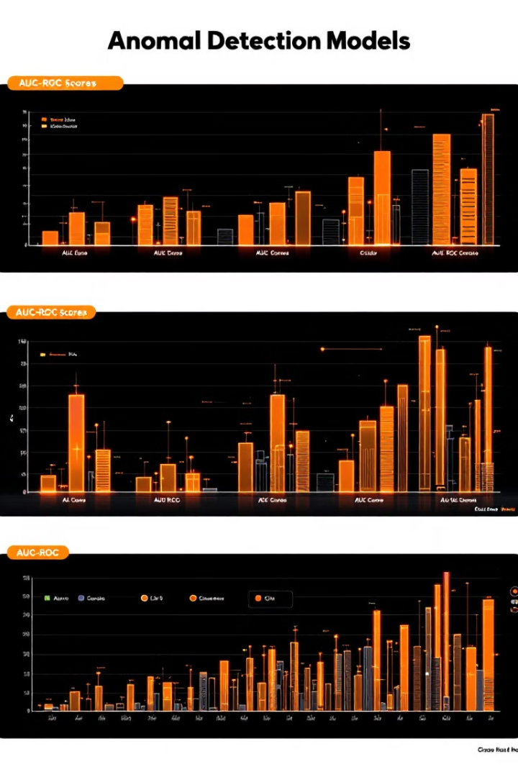
Model Performance Metrics
Model performance is evaluated using various metrics to assess their ability to detect anomalies in credit card transactions. These metrics provide insights into the model's accuracy, precision, recall, and overall effectiveness.
Key metrics include AUC-ROC score, classification report, and confusion matrix. AUC-ROC score measures the model's ability to distinguish between normal and anomalous transactions. The classification report provides a detailed breakdown of precision, recall, and F1-score for each class. The confusion matrix visualizes the model's predictions, highlighting true positives, true negatives, false positives, and false negatives.

Slide 16
Model Comparison
Model Performance
Model Limitations
Model Selection
The Random Forest model achieved the highest F1-score of 84%, indicating a good balance between precision and recall. It also had the highest ROC-AUC score of 0.953, suggesting strong performance in distinguishing fraudulent transactions from legitimate ones.
The Gaussian Mixture Model had a low recall of 13%, indicating that it missed many fraudulent transactions. The Isolation Forest model had a recall of 0%, suggesting it failed to identify any fraudulent transactions.
Based on the performance metrics, the Random Forest model appears to be the most effective for detecting anomalies in credit card transactions. It achieved a good balance between precision and recall, indicating its ability to accurately identify fraudulent transactions while minimizing false positives.

Slide 17


Conclusion and Future Enhancements
Model Performance
Future Enhancements
Random Forest emerged as the top performer, achieving a precision of 96%, recall of 74%, and an ROC-AUC score of 0.953. It effectively balanced high recall and low false positives.
Future enhancements could include exploring deep learning approaches like Autoencoders for anomaly detection. Incorporating domain-specific features could also improve model accuracy.

Slide 18
Participant Contributions
SATYA SHIVA SAI RAM KAMMA
TANUSH BHASKAR SHETTY
GURNIT S CHAUHAN
CHAD T CHIU
Prepared the data by cleaning and preprocessing it, then used the Random Forest algorithm to identify unusual transactions and report writing.
Utilized GMM, to identify patterns in the data and flag anomalies that deviate from these patterns and report writing.
Simplified the data using PCA to reduce its complexity and improve the efficiency of the anomaly detection models.
Employed Isolation Forest, an ensemble method, to isolate anomalous data points. Additionally, fine-tuned the models to enhance their accuracy and performance.

